Slide 1
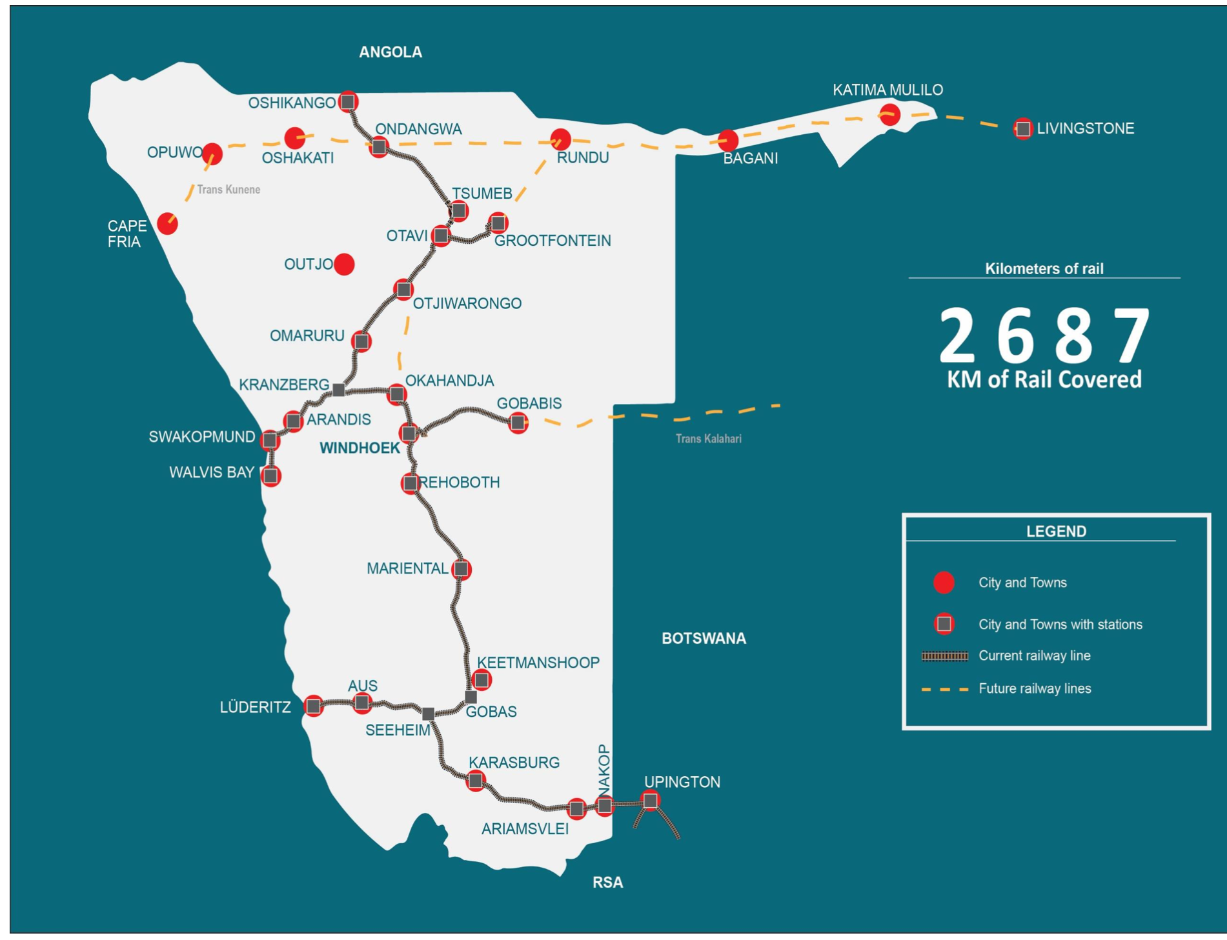
The Continental Workshop for the Implementation of the African Integrated Railway Network (AIRN) Project
07 May, Dar es Salaam
Presentor: Dr. Helvi Petrus

Slide 2
Outline
1. Namibia Logistics Hub
2. National Perspective
3. Namibia Railway Network
4. Challenges
5. Opportunities

Slide 3
Logistics Hub perspective

Slide 4
National perspective
Namibia developed various transport corridors into Africa
Walvis Bay-Ndola-Lubumbashi Development Corridor
Trans Kalahari Corridor
Trans Cunene Corridor
Trans Oranje Corridor
GRN investments in Walvis Bay Port expansion & fuel storage
Dry ports for Botswana, Zimbabwe and Zambia at Walvis Bay Port

Slide 5
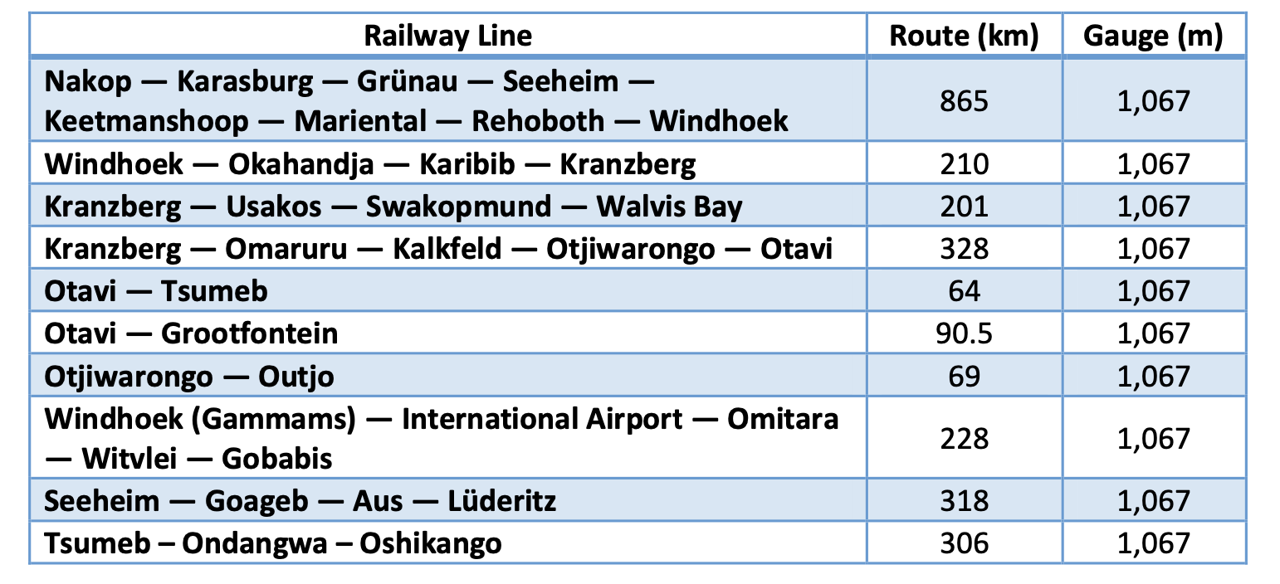
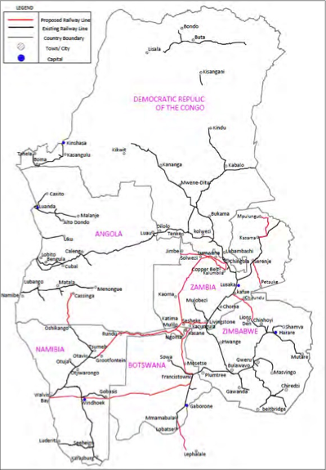
The Namibian Railway network and railway routes

Slide 6
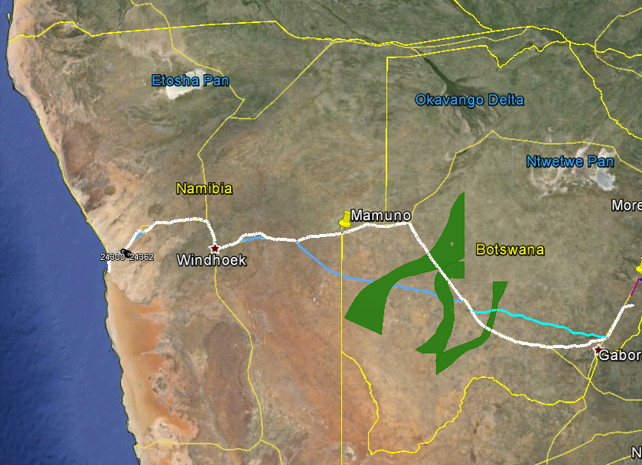
Accelerated pilot-Trans Kalahari Rail links
The railway route alignment in Namibia is from Trans-Kalahari (Buitepos) Border post running on the western side of the road alignment through to Gobabis; through Omitara to Okahandja then following the existing TransNamib railway network terminating behind Dune 7, where the loading facilities will lead to a deep port around Langstrand, hopefully by a conveyor belt.
Notes:
The railway route alignment in Namibia is from Trans-Kalahari (Buitepos) Border post running on the western side of the road alignment through to Gobabis; through Omitara to Okahandja (by-passing Windhoek) then following the existing TransNamib railway network terminating behind Dune 7, where the loading facilities will lead to a deep port around Langstrand, hopefully by a conveyor belt.

Slide 7
Railway Trajectory
Pre-feasibility study- 2010
TKR Project Study- 2016
AUDA-NEPAD-2020
Bilateral Agreement signed
Project Management Office established- 2014
Towards Agenda 2063 implementation plan
Towards regional harmonisation

Slide 8
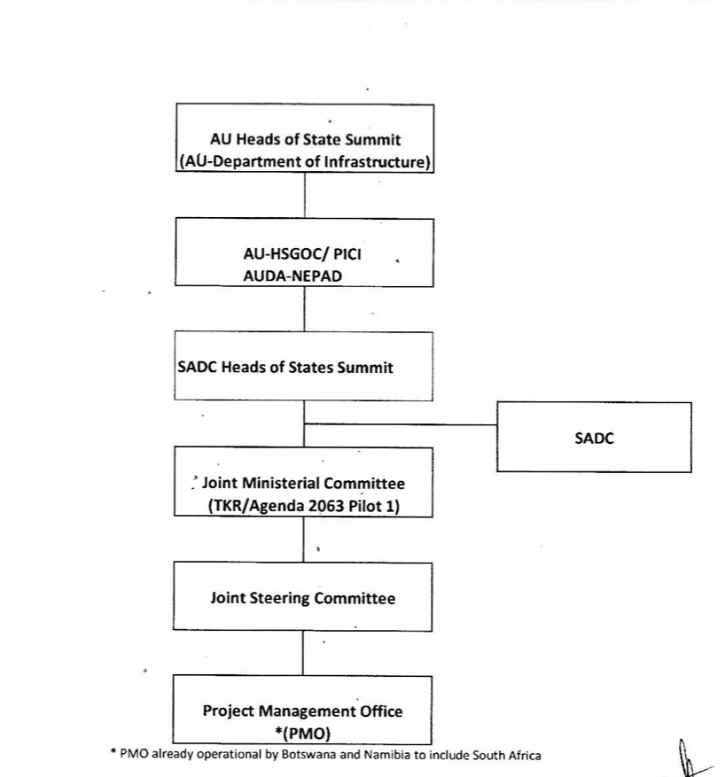

Implementation Framework

Slide 9
Achievements
Nov. 2010
Signing of the MOU between the two governmnet
2011
Pre-Feasibility study
Mar. 2014
Signing of the Bilateral agreement
Sep. 2014
Project management office (PMO) agreement
2015
Operationalisation of the Project management office
2016
Trans Kalahari Railway development study
2017
Development of the PMO policies
May 2023
Road map (implementation plan) approval
Sep.–Nov. 2023
Expression of interest- Funding and implementation of the project (September –Nov 2023) check on the website

Slide 10
Achievements
Evaluated the submission from EOI
Next step
Appoint based on the submission received (on a PPP level)
Consultancy to do the evaluation

Slide 11
AIHSRN-Intergrated Master Plan 2033 & 2043
Master Plan 2033
Link 35 Walvis Bay- Windhoek 269
Link 36 Windhoek- Gabrone 1026
Link 37 Gabrone- Johannesburg 348
Master Plan 2043
Link 58 Luanda, Angola-Windhoek, Namibia 1882
Link 59 Windhoek, Namibia, Cape Town 1632

Slide 12
Challenges
Insufficient railway infrastructure connectivity
Dilapidated railway infrastructures
Lack of adequate rolling stock to satisfy demand
Institutional constraint ( skills, regulatory & operator)
Limited funding towards railway rehabilitation
Change in price for coal

Slide 13

Opportunities
Green Hydrogen
Use of renewable energy in the manufacturing and supply of railway infrastructure and rolling stock.
Hydrogen train
Political will
Downstream activities
Exploration of other commodities (based on the feasibility study) fuel, Iron ore
Notes:
The signing of the Feasibility and Implementation Agreement (FIA) between the Namibian Government and Hyphen to produce green hydrogen and its derivatives is an important milestone for Namibia and the transport sector.

Slide 14
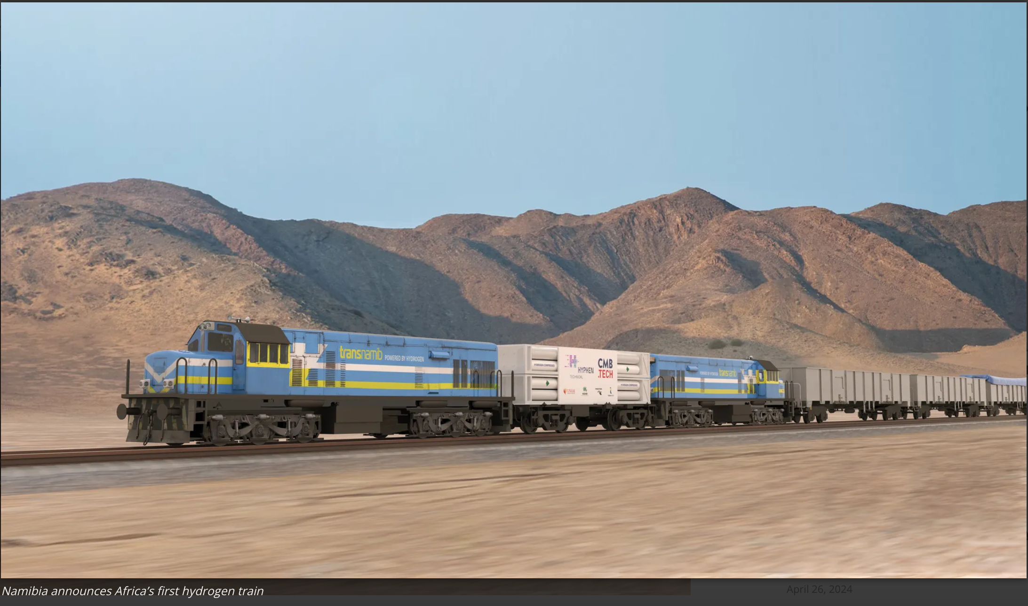
Thank you

